Slide 1
Use Permit 25-014 Mann Short-Term Rental Mono County Planning Commission December 18, 2025

Slide 2
Project Description
Location: 122 Nevada Street, June Lake, CA
Land Use Designation: Single-Family Residential (SFR)
Parcel Size: 0.18 acres
Proposed Project: Use Permit to allow non-owner-occupied short-term rentals

Slide 3
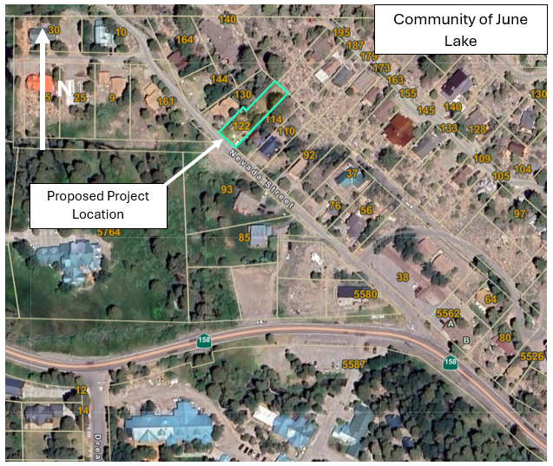
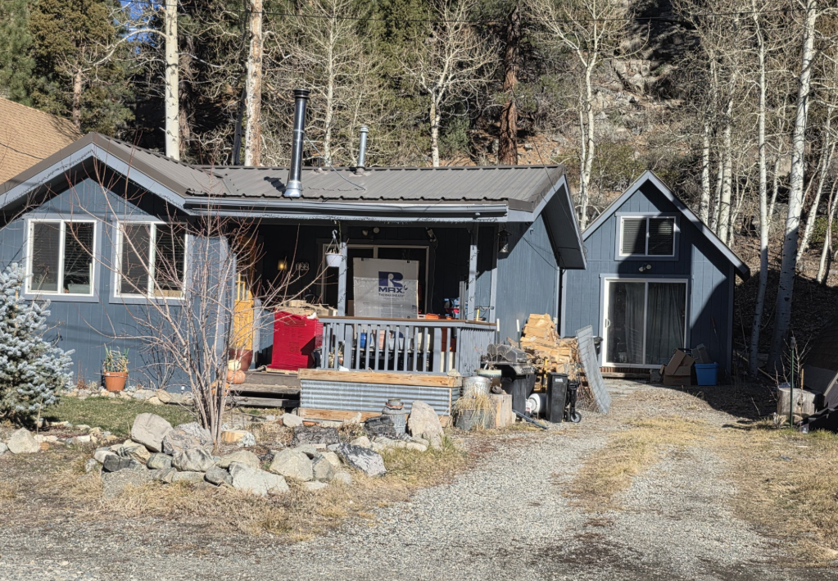
Project Description & Location
122 Nevada Street
2 BR/ 1 BA
Smaller bedroom is proposed for a yoga/reading room
611 square feet
Surrounding LUD: Single-Family Residential, Estate Residential, and Commercial Lodging

Slide 4
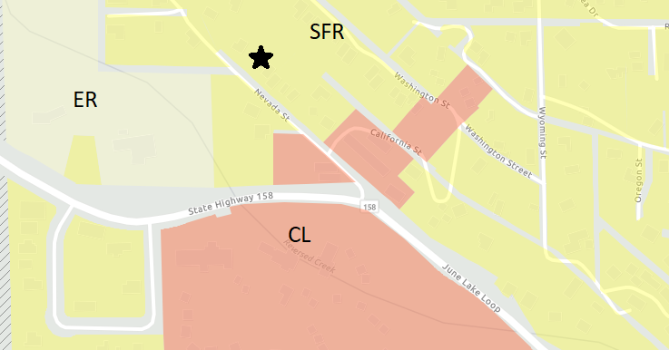
Land Use Designations
Double Eagle Resort
Whispering Pines Motel
Double Eagle Resort & Spa

Slide 5
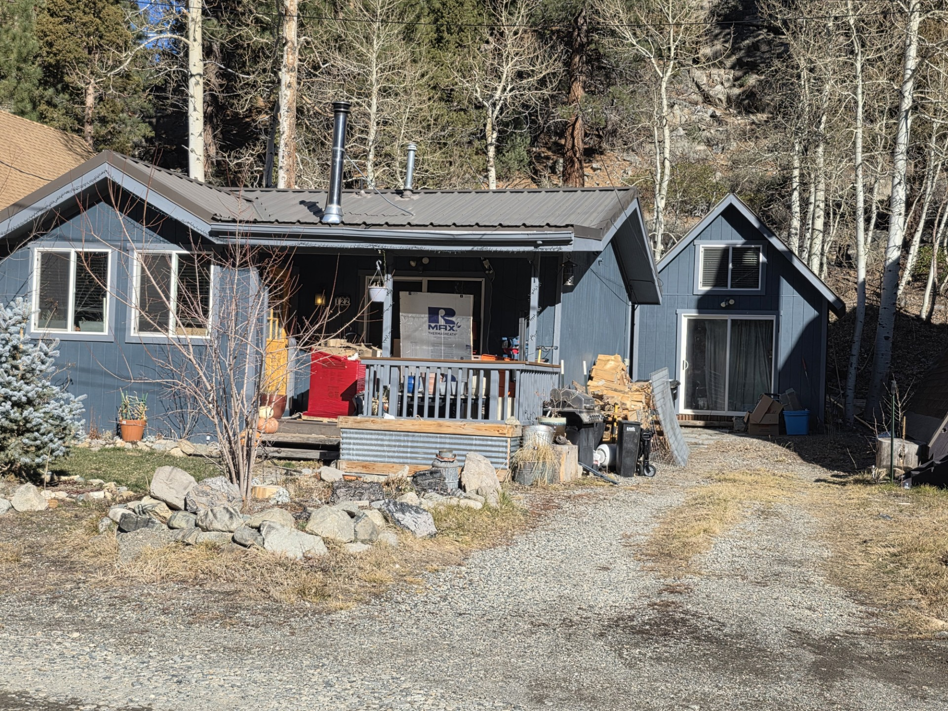
Issues noted in 2024 Denial
Reduction in local resident or workforce housing during local housing crisis. Small 611 square foot house is great for starter home.
STR is making homes an investment property. Takes away from long-term renters or employee housing.
Access road issue as wildfires increase, could cause impact to traffic and emergency access.
Garbage disposal and protecting wildlife and improper trash storage, litter. Past issues with STR visitors.

Slide 6
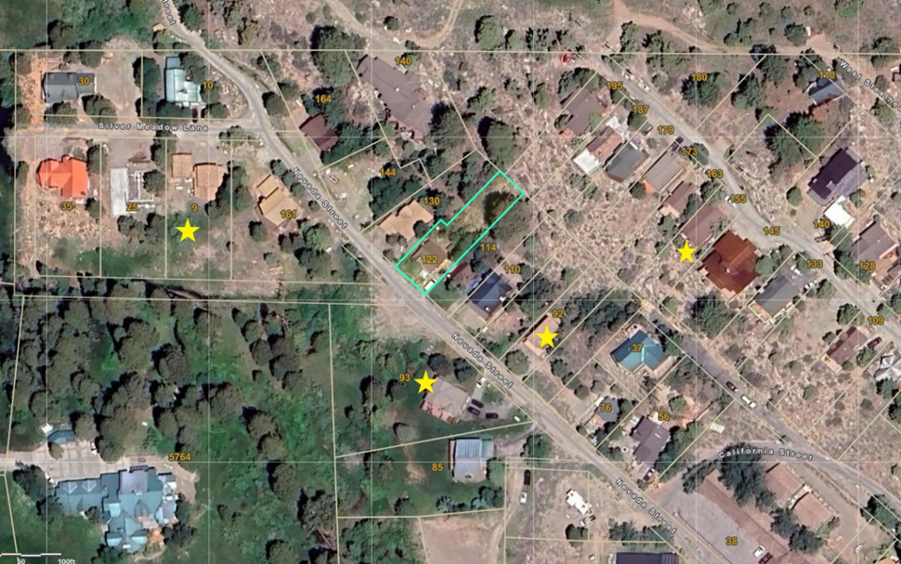
Existing overnight rentals
Four existing within 400’ of proposed project site

Slide 7
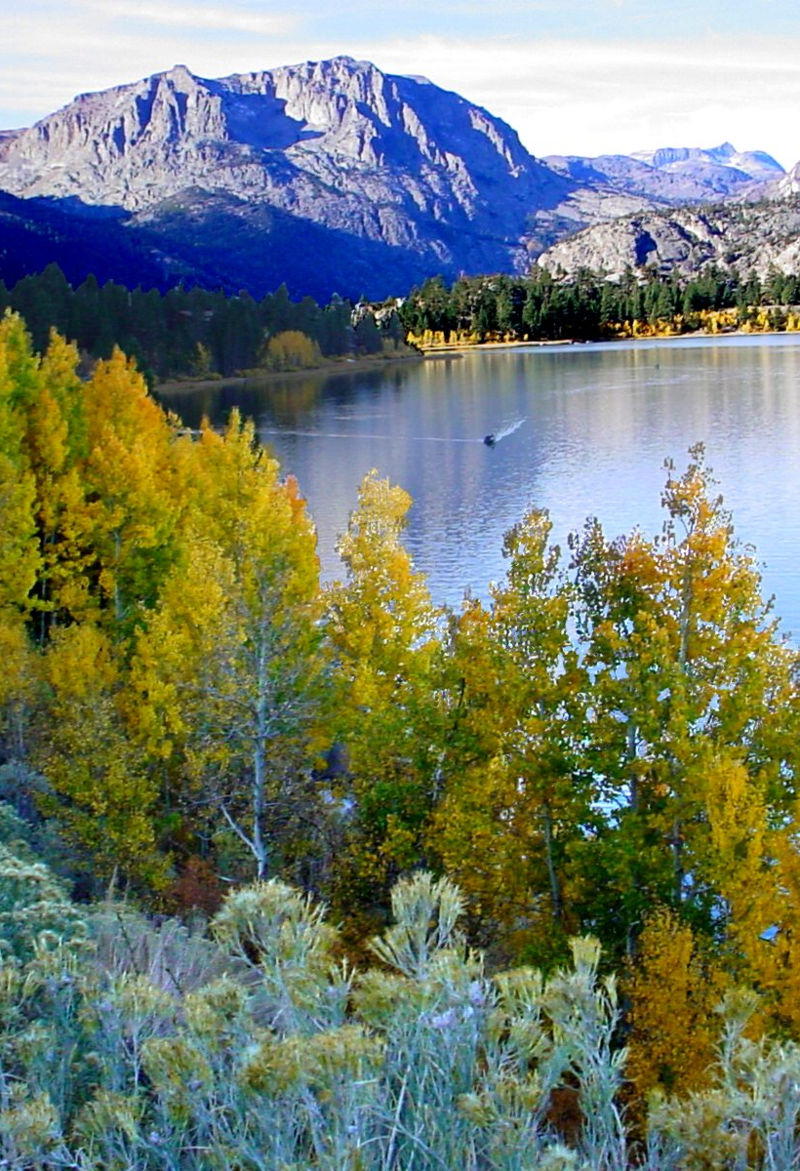
Lot Coverage Setbacks Parking Access Road Snow Storage Dark Sky

Slide 8
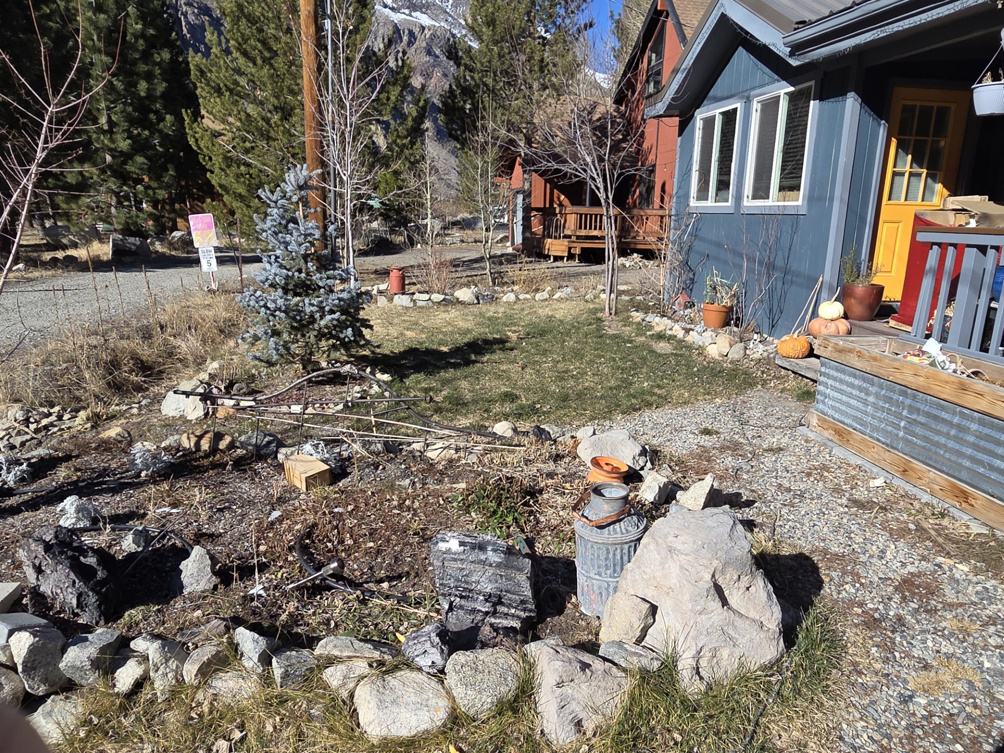
Lot Coverage
Setbacks
GP allows max 40%.
House + detached guesthouse (shed storage) 13.2%
GP SFR regulations allows min setbacks 20’ Front, 10’ Rear, 10’ Sides.
Existing nonconforming setback on the western side property line (~6.5’)
House built 1977
Compliant with front, eastern side, and rear setbacks

Slide 9
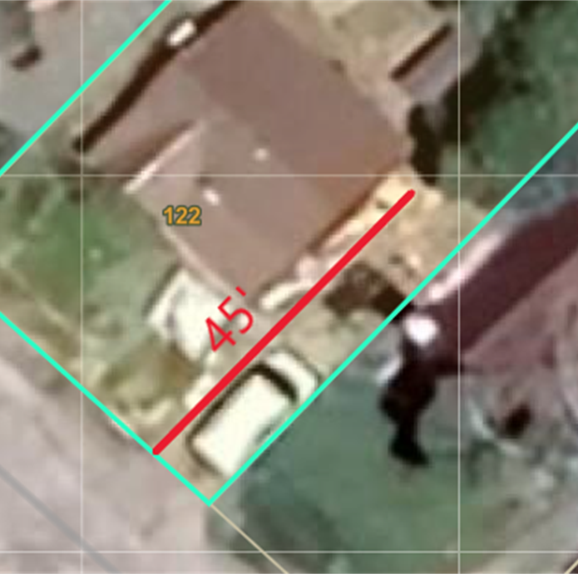
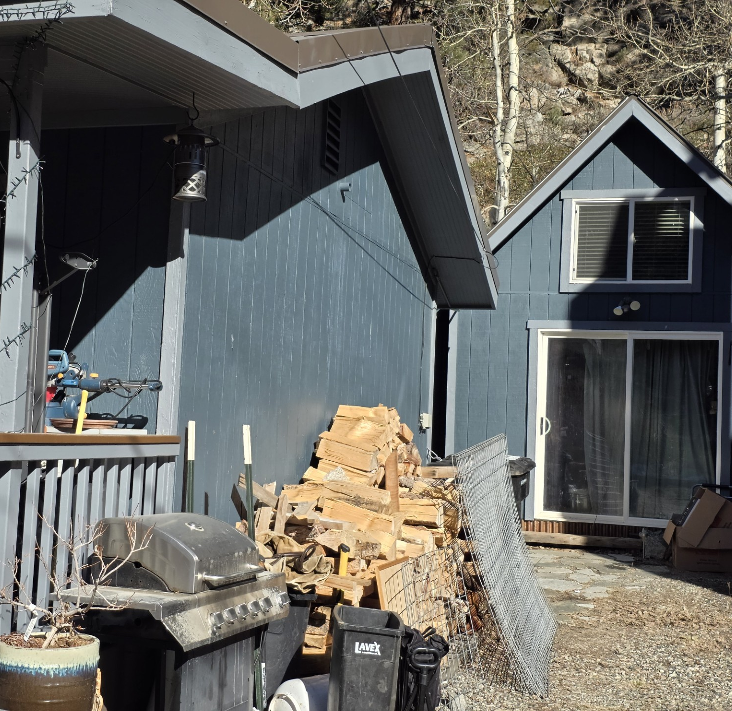
Parking
10’
SFR requires two parking spaces 10’ x 20’
Driveway is 45’ x 10’ two uncovered tandem spaces
Meets requirement and condition that all parking must be contained on-site and number of vehicles permitted shall not exceed number of parking spaces
STR guests will be limited to two vehicles

Slide 10
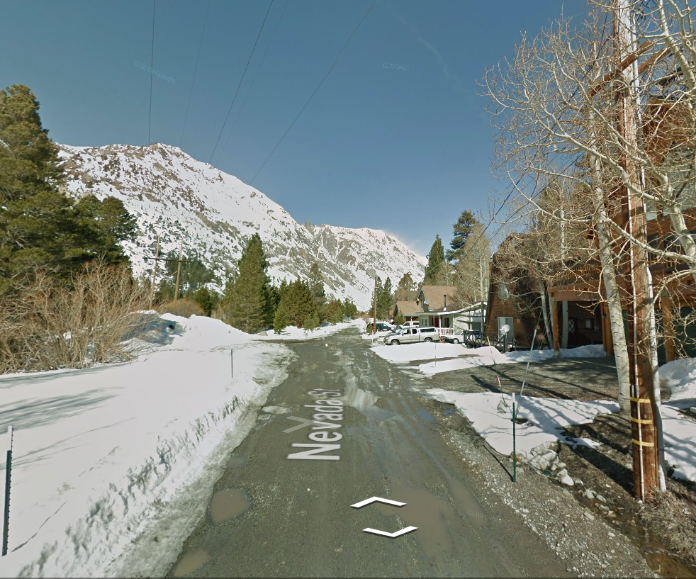
Access road
Existing roads not required to upgrade to standards by MCGP LUE Ch. 22 Fire Safe Regulations or State Minimum Fire Safe Regulations.
Notice sent to June Lake PUD and June Lake Fire Dept. 11/3/2025. No comments were made.
The access road (Nevada Street) is existing nonconforming, unimproved, 16’ wide with no turnaround along or at terminus. Single only access point.
MCGP LUE Action 1.M.3.A can deny STR application if emergency access issues present due to single access point or if parcel is accessed is unimproved dirt road.

Slide 11
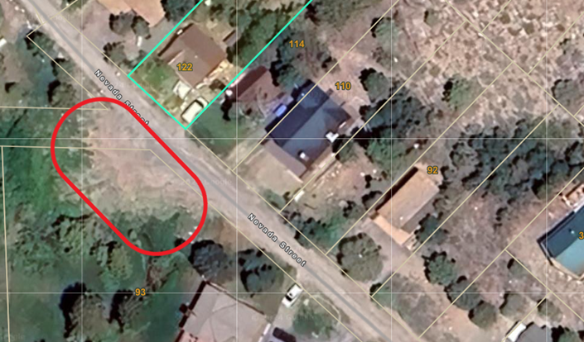
Snow Storage
Prior to STR Activity Permit, applicant must a) obtain written permission from owner of 93 Nevada Street, or b) instruct plow driver to store snow in applicant’s front yard.
Applicant has letter from 93 Nevada Street owner.
Residents on Nevada Street have contracted for plowing services and applicant contributes funds with additional fee to plow her driveway

Slide 12
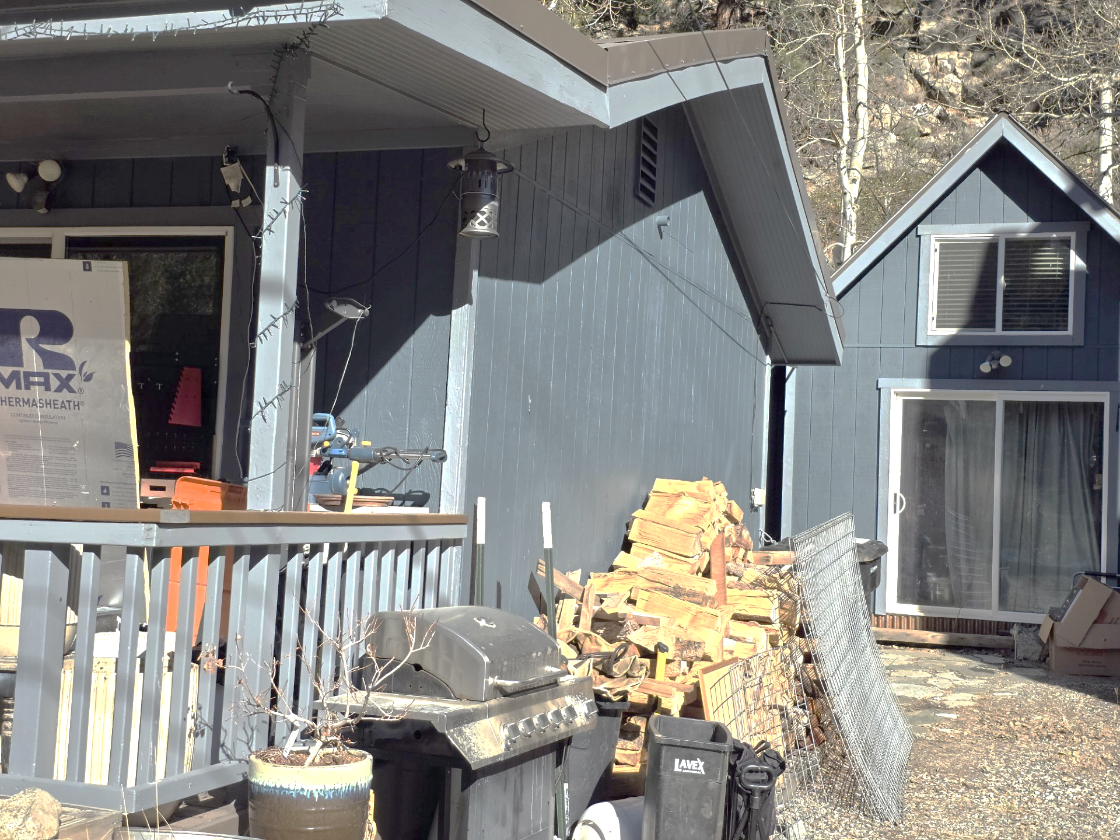
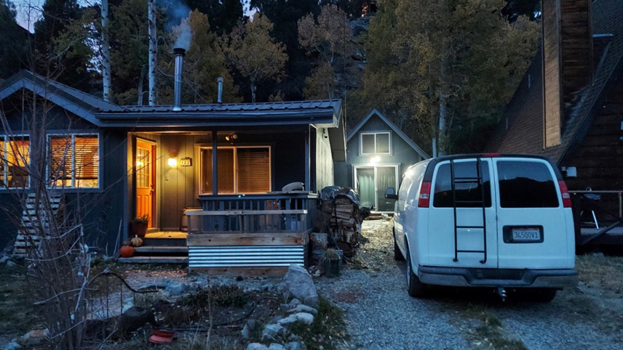

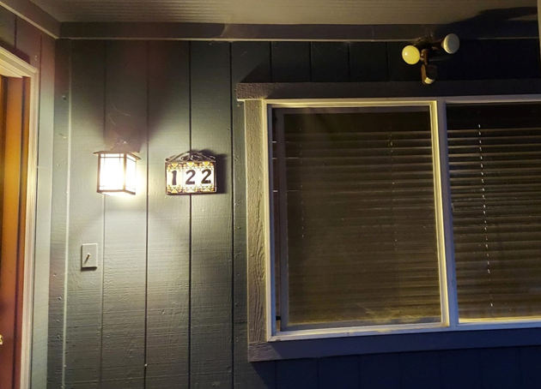
Dark SKy
External lights must comply with MCGP LUE Ch. 23 Dark Sky Regulations
Exterior lights are not compliant as of 12/10/25

Slide 13
California Environmental Quality Act (CEQA)
If short-term rental use permit is approved, the project is consistent with Class 1 CEQA exemption §15301: operation, repair, maintenance, permitting, leasing, licensing, or minor alteration of existing public or private structures, facilities, mechanical equipment, or topographical features, involving negligible or no expansion of existing or former use.
OR
If short-term rental use permit is NOT approved, the project is statutorily exempt with CEQA §15270: Projects which are disapproved.

Slide 14
General Plan Consistency
The project is consistent and compliant with Countywide Land Use policies & June Lake Area Plan (opportunities / constraints / issues)
Policies are listed in the staff report in detail.
Single-Family Residential LUD “provide for the development of single-family dwelling units in community area.”
STRs are permitted in SFR LUD subject:
Use Permit (UP25-014)
MCGP LUE Ch. 25 (STR)
MCC Ch. 5.65 (STR activity permit)

Slide 15
Land development technical advisory (LDTAC)
Public Comments
Support: positive impacts on traffic and neighborhood aesthetics. Owner of overnight rental property 93 Nevada Street.
Oppose: Concerns for retaining quiet neighborhood and small-town nature or June Lake, traffic impacts, visitor nuisances, trash and noise
Application was accepted at LDTAC September 15, 2025.
Conditions of Approval accepted November 17, 2025.
Mailer notices sent to neighbors within 300 feet of project site October, 10, 2025. Four comment letters have been received – 3 support, 1 oppose. All from neighbors in the Upper Clark Tract, June Lake Community
Newspaper The Mammoth Times sent October 16, 2025.
Planning Commission November 20, 2025 applicant requested public hearing to go to December 18, 2025.

Slide 16
Conditions of Approval
Occupancy shall not exceed four renters and two vehicles during short-term rentals.
Two parking spaces within the driveway shall be available to short-term rental guests.
Vehicle parking shall occur only on the property and as designated in the existing driveway. Off-site and on-street parking are prohibited. Vehicle(s) shall not obstruct the flow of traffic on Nevada Street.
The June Lake Fire Department shall be notified prior to beginning operation as a short-term rental and the project is required to comply with any requirements of the June Lake Fire Department.
All short-term rental customers must sleep within the primary dwelling; customers are not allowed to reside in an RV, travel-trailer, or similar mobile-living unit on the property or any neighboring property. Guesthouse shall not be used during short-term rentals.

Slide 17
Conditions of Approval
The project shall comply with provisions of the Mono County General Plan (including Chapter 25, Short-Term Rentals), Mono County Code (including but not limited to 10.16.060(A)), and project description and conditions. The project shall also comply with all provisions of Mono County Code Chapter 5.65, Short-Term Rental Activity in Residential Land Use Designations, and Chapter 25 of the Mono County General Plan Land Use Element. The applicant must also obtain an STR Activity Permit, transient occupancy tax certificate, and business license, as well as pay housing mitigation ordinance fees prior to commencing operation as a short-term rental.
Project shall comply with applicable requirements by other Mono County departments and divisions including, but not limited to, Mono County Building Division, Public Works, and Environmental Health requirements, and any California state health orders.
Prior to issuance of a Short-Term Rental Activity Permit per Mono County Code Chapter 5.65, all exterior lighting shall be fully shielded and directed downward to comply with MCGP LUE Chapter 23, Dark Sky Regulations.
Prior to issuance of a Short-Term Rental Activity Permit, the applicant shall either (a) obtain express permission for snow storage from the owner of 93 Nevada Street, or (b) instruct the plow driver that is under contract to plow Nevada Street and the applicant’s driveway to store the snow from the applicant’s driveway in the applicant’s front yard.
Use Permit is not valid until all county fees are paid in full.
Appeal
Termination
Extension
Revocation

Slide 18
Finding #1
All applicable provisions of the Mono County General Plan are complied with, and the site of the proposed use is adequate in size and shape to accommodate the use and to accommodate all yards, walls and fences, parking, loading, landscaping and other required features because:
Project site has adequate parking with gravel driveway.
STRs are permitted in SFR LUD; subject to Use Permit.
Proposed project meets all MCGP LUE and policies, except:
Western side setback (existing nonconforming)
Dark Sky exterior lights noncompliant
This finding can be made

Slide 19
Finding #2
The site for the proposed use relates to streets and highways adequate in width and type to carry the quantity and kind of traffic generated by the proposed use.
The kind of traffic generated by the proposed use is similar to that of the existing residential uses or a long-term rental.
No comments from June Lake Fire Department.
This finding can be made.
Or

Slide 20
Alternative Finding #2
The project site has insufficient emergency access on unimproved, 16’ wide, dirt road. Nevada Street is existing nonconforming road with no turnaround along or at terminus.
Single only access point which lacks a secondary ingress/egress route.
Road maintenance and snow removal is shared by surrounding homeowners and the applicant which benefits the applicant’s STR use.
This finding cannot be made.

Slide 21
Finding #3
The proposed use will not be detrimental to the public welfare or injurious to property or improvements in the area on which the property is located:
The project will comply with MCGP LUE Ch. 25 and MCC Ch. 5.65
The project provides for additional visitor accommodations.
The project is not expected to cause significant environmental impacts.
The project will comply with all June Lake Fire Department requirements.
Plowing services will be contracted for snow removal and storage on the neighboring property owner’s parcel or on applicant’s driveway.
This finding can be made.
Or

Slide 22
Alternative Finding #3
Due to the lack of available housing for local residents and employees, a reduction of a small sized home in the residential housing stock for long-term renter or first-time homeowner is detrimental to the public welfare.
Visitor accommodations are already provided through facilities built for that purpose such as hotels and motels nearby.
An additional STR on Nevada Street can impact the density of overnight rentals in a SFR LUD neighborhood.
The proposed project impacts neighboring property owners because of road conditions and potential emergency access issues which may cause public safety issues.
This finding cannot be made.

Slide 23
Finding #4
The proposed use is consistent with the map and text of the Mono County General Plan:
Single-Family Residential LUD allows the use of short-term rental on a property in Ch. 25 and June Lake Area Plan policies.
Project subject to STR policies specific to Nevada Street and Silver Meadow Lane, allows year-round, not owner-occupied STRs.
Project site is in the June Lake Area Plan which encourages a range of commercial uses and services for residents and tourists.
This finding can be made.
Or

Slide 24
Alternative Finding #4
Four overnight rentals already exist within 400 feet of project site. This exceeds the density of limited form STRs in residential neighborhood MCGL LUE policy 1.M.4.a
Project poses potential issues with protecting existing and future property owners; possible land use conflicts.
This finding cannot be made.

Slide 25
Recommendation
Hold public hearing, receive public testimony, deliberate project, and make any desired changes;
Find project qualifies as Categorical Exemption CEQA §15301 and instruct staff to file NOE;
Make required findings as contained in project staff report and approve Use Permit 25-014 subject to Conditions of Approval.
or
Alternative Recommendation: As contained in the staff report, determine that the required findings cannot be made and disapprove the project. Disapproval of a project is a Statutory Exemption under CEQA Guidelines §15270.

