Slide 1
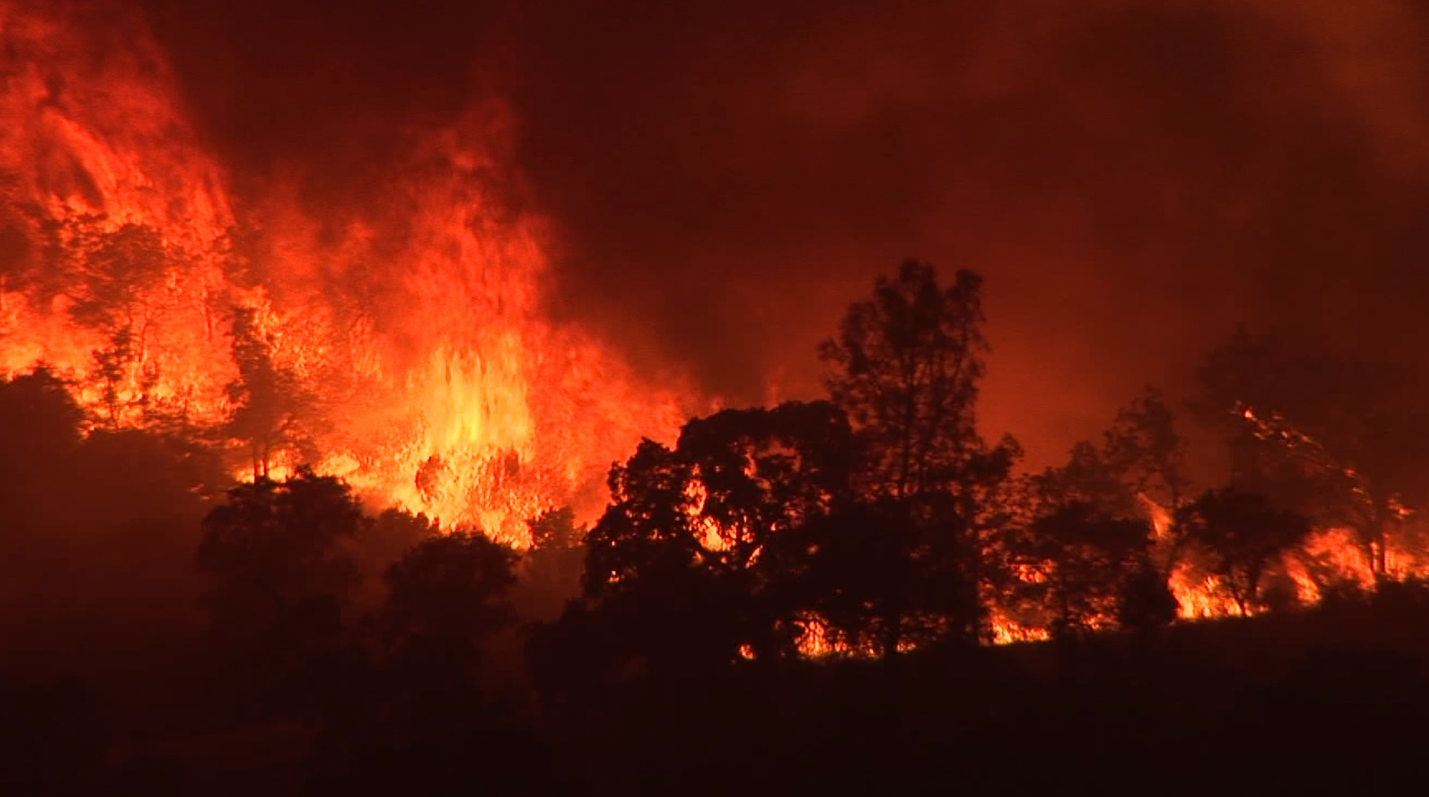
2023 Updated
State Minimum Fire Safe Regulations
11/16/23
Mono County Planning Commission

Slide 2
2023 Updated
State Minimum Fire Safe Regulations
California Code of Regulations
Title 14 Natural Resources
Division 1.5 Department of Forestry
Chapter 7 – Fire Protection
Subchapter 2 State Minimum Fire Safe Regulations
Articles 1-5

Slide 3
2023 Updated
State Minimum Fire Safe Regulations
Updated Regulations effective April 1, 2023
Supersede GP LUE CH 22 Fire Safe Regulations

Slide 4
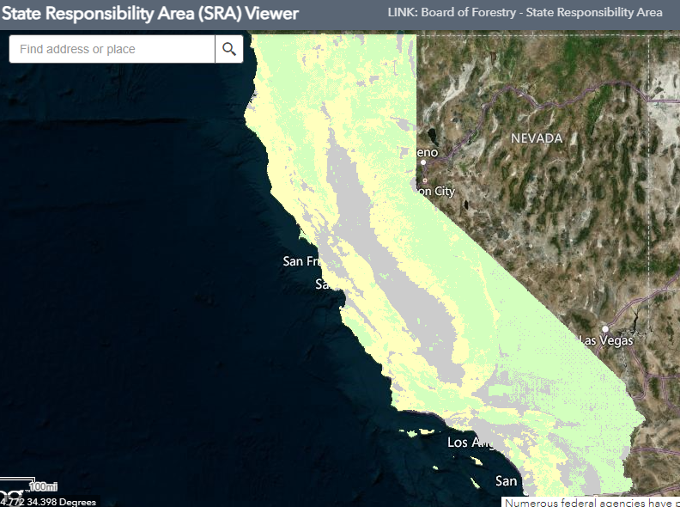

Slide 5
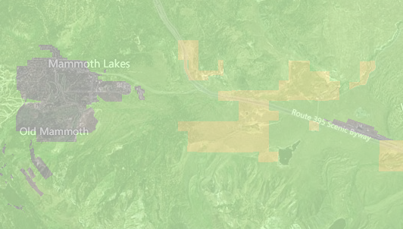
LRA = Incorporated Cities

Slide 6
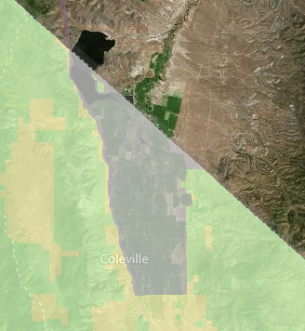
LRA = Geography
Irrigated Agriculture
Desert
Unincorporated Urban Areas

Slide 7
Updated Regulations Apply To:
New “Buildings”
Residential
Commercial
Industrial
Including Manufactured Homes/Mobile homes
Parcel/Tract Maps
Other “Development”
Use Permits
Roads
Bridges

Slide 8
Updated Regulations Do Not Apply To:
Existing Buildings (Additions, Remodels)
Roads exclusively for agriculture, mining, timber harvest.
????? Certain activities on parcels created before 1991 ?????

Slide 9
Updated Regulations Include:
Roads (Including Driveways)
Road Width
Road Surface
Road Grades
Turning Radii
Turnarounds
Turnouts
Road Structures (Bridges)
Dead-End Roads
Gates
Road Signage
Definitions
Addressing
Emergency Water
Hydrants
Setbacks
Ridgelines
Fuel Breaks
Greenbelts/Open Space

Slide 10
Updated Regulations Do Not Include:
Roof Coverings CBC
Defensible Space PRC 4291

Slide 11
Updated Regulations Include:
Roads (Including Driveways)
Road Width
Road Surface
Road Grades
Turning Radii
Turnarounds
Turnouts
Road Structures (Bridges)
Dead-End Roads
Gates
Road Signage
Definitions
Addressing
Emergency Water
Hydrants
Setbacks
Ridgelines
Fuel Breaks
Greenbelts/Open Space

Slide 12
Updated Regulations Include:
Roads (Including Driveways)
Road Width
Road Surface
Road Grades
Turning Radii
Turnarounds
Turnouts
Road Structures (Bridges)
Dead-End Roads
Gates
Road Signage
Definitions
Addressing
Emergency Water
Hydrants
Setbacks
Ridgelines
Fuel Breaks
Greenbelts/Open Space

Slide 13
Updated Regulations Include:
Roads (Including Driveways)
Road Width
Road Surface
Road Grades
Turning Radii
Turnarounds
Turnouts
Road Structures (Bridges)
Dead-End Roads
Gates
Road Signage
Definitions
Addressing
Emergency Water
Hydrants
Setbacks
Ridgelines
Fuel Breaks
Greenbelts/Open Space

Slide 14
Updated Regulations Include:
Roads (Including Driveways)
Road Width
Road Surface
Road Grades
Turning Radii
Turnarounds
Turnouts
Road Structures (Bridges)
Dead-End Roads
Gates
Road Signage
Definitions
Addressing
Emergency Water
Hydrants
Setbacks
Ridgelines
Fuel Breaks
Greenbelts/Open Space

Slide 15
Updated Regulations Include:
Road Grades
Previous maximum grade of 16%
Update allows for maximum grade of 20% in certain circumstances
Emergency Water
Previous Referenced NFPA 2012 Standard
Update References NFPA 2017 Standard
Hydrants
Previous detailed location requirements
Update References California Fire Code

Slide 16
Updated Regulations Include:
NEW Ridgelines
Required to Identify Strategic Ridgelines
Prohibit Development within Strategic Ridgelines
NEW Fuel Breaks
Determine Need and Requirements
Ensure Maintenance
NEW Greenbelts/Open Space
Conform with Requirements of Fuel Breaks

Slide 17
Updated Regulations Include:
Many Updates to Definitions
1276.01 Building and Parcel Siting and Setbacks
(a) All parcels shall provide a minimum (30) foot setback for all Buildings from all property lines and/or the center of a Road…
…except as provided for in subsection (b)

Slide 18
PART 1 of 2
1276.01 (b)
A reduction in the minimum setback shall be based upon practical reasons, which may include but are not limited to,
-Parcel Dimensions or Size
-Topographic Limitations
-Development Density Requirements
-Sensitive Habitat
-Other Site Constraints
AND….

Slide 19
PART 2 of 2
1276.01 (b)
Shall provide for an alternative method to reduce Structure-to-Structure ignition by incorporating features such as, but not limited to:
-Non-Combustible Block Walls or Fences
-Non Combustible Material extending 5ft. Horizontally
-Hardscape Landscaping
-Reduction of Exposed Windows
-The Most Protective Requirements of the California Building Code, Title 24, Part 2 Ch 7A

Slide 20
1270.07 Exceptions to Standards
Based on providing “Same Practical Effect”.
Findings Required
Can be Granted by Local Jurisdiction or CalFire.
Can be Appealed to Local Jurisdiction or CalFire.
Current Policy
County is Not Granting Exceptions to State Law

Slide 21
How are the 30-foot setbacks working out?

Slide 22
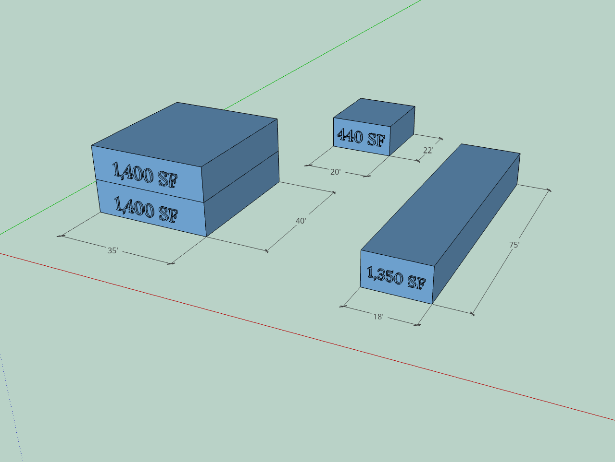

Slide 23
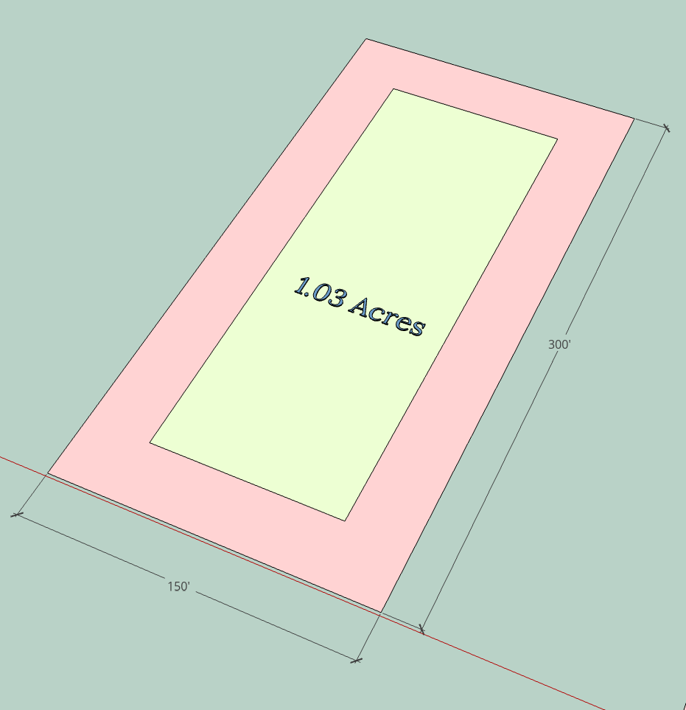

Slide 24
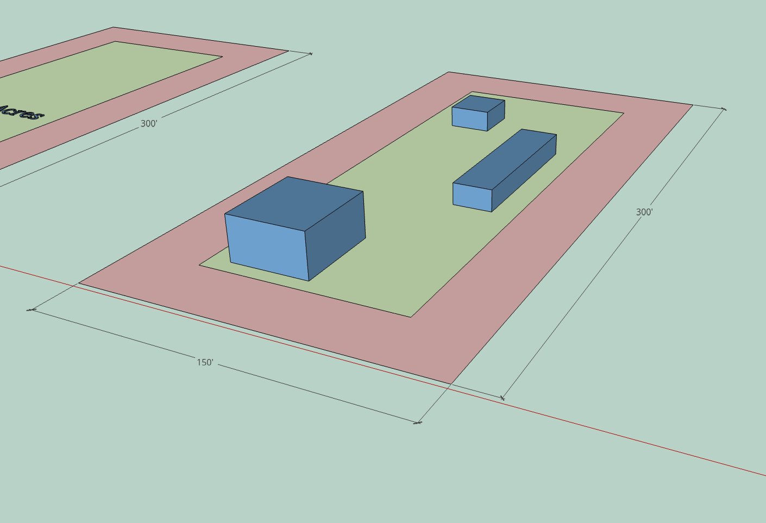

Slide 25
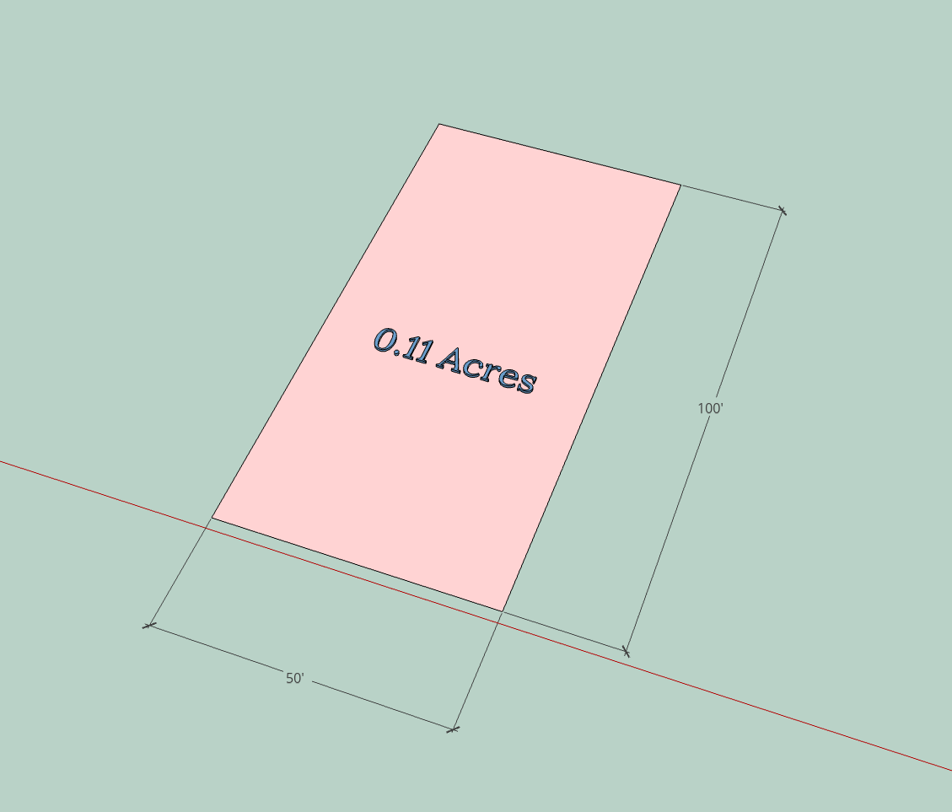

Slide 26
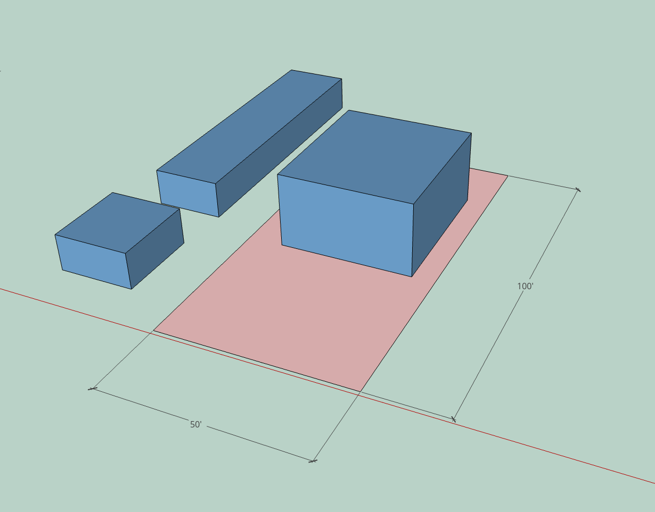

Slide 27
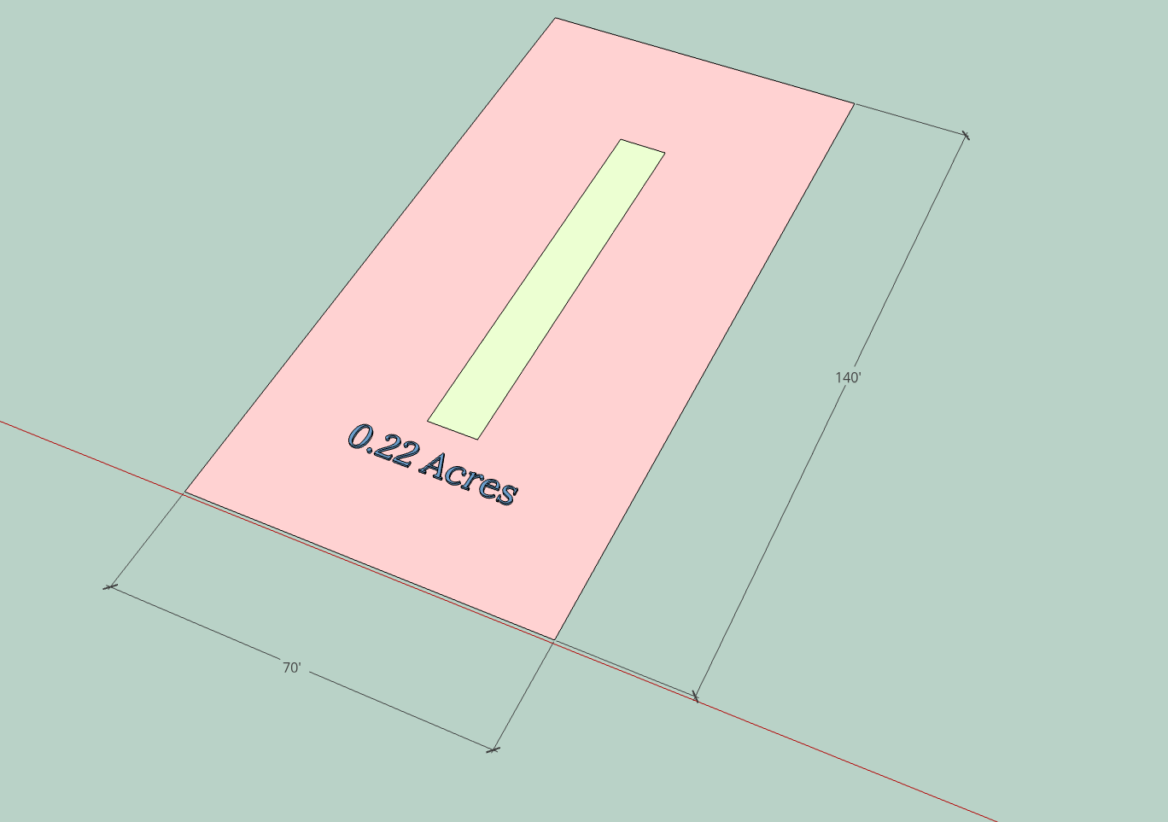

Slide 28
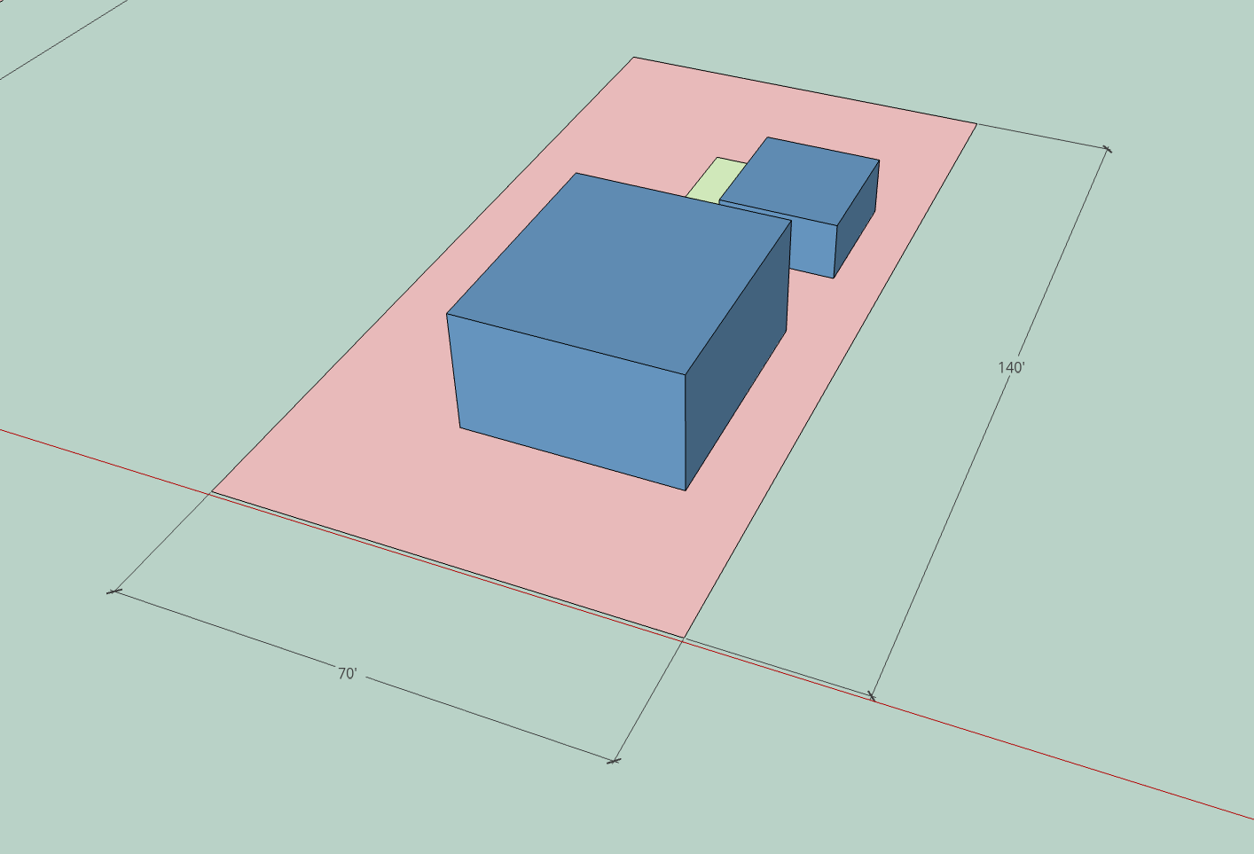

Slide 29
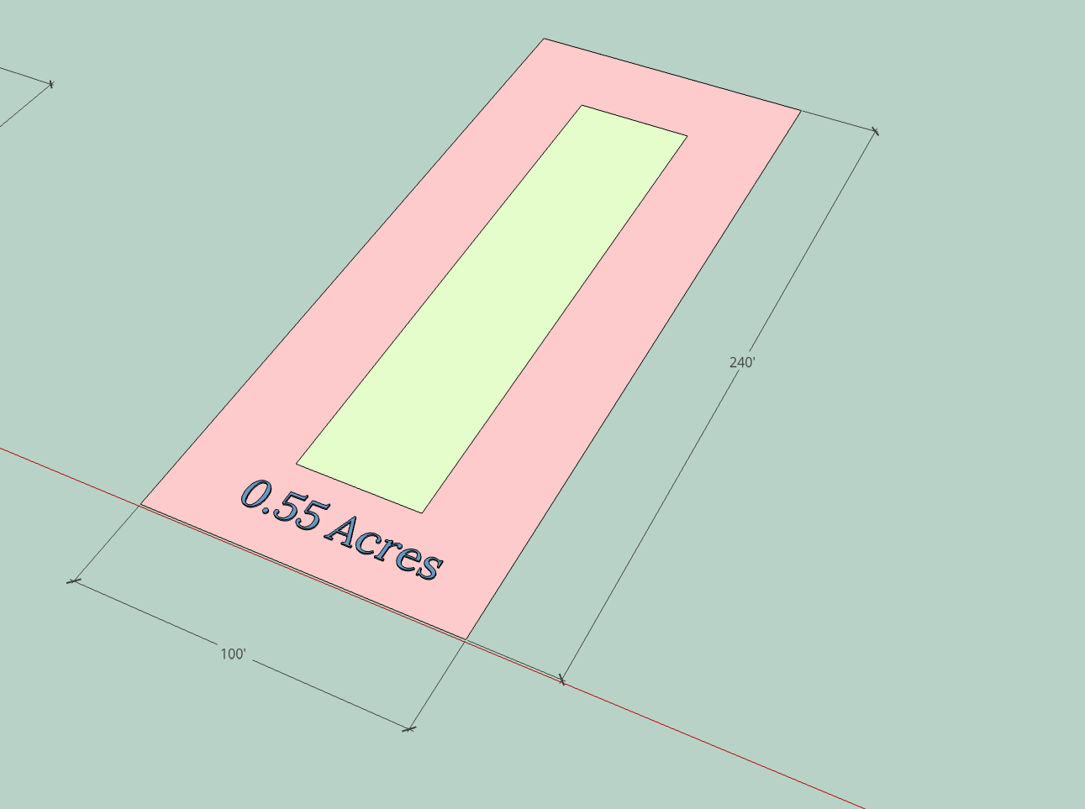

Slide 30
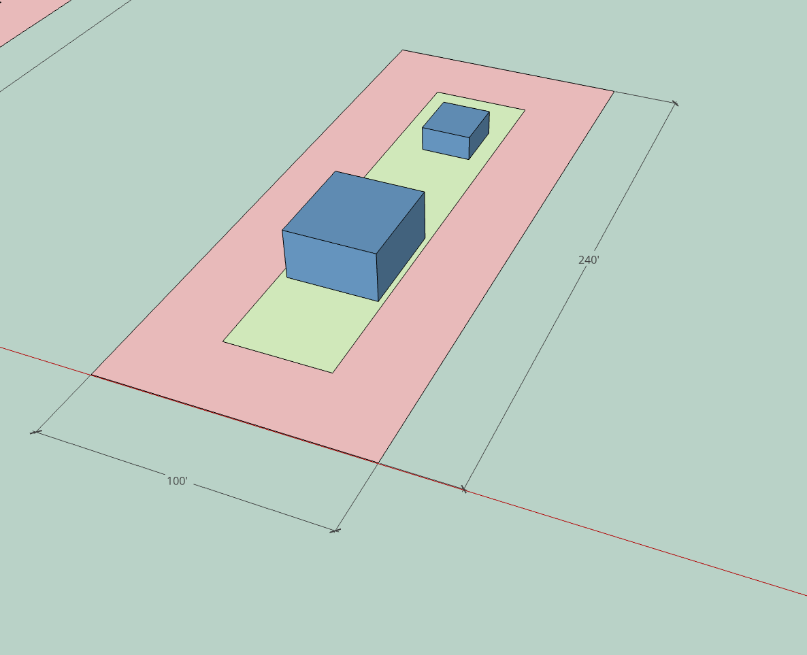

Slide 31
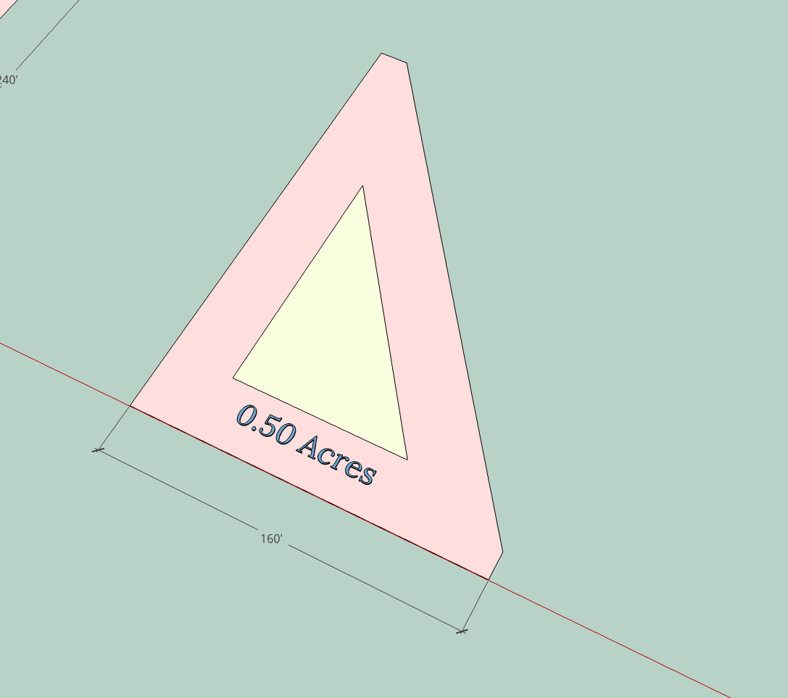

Slide 32
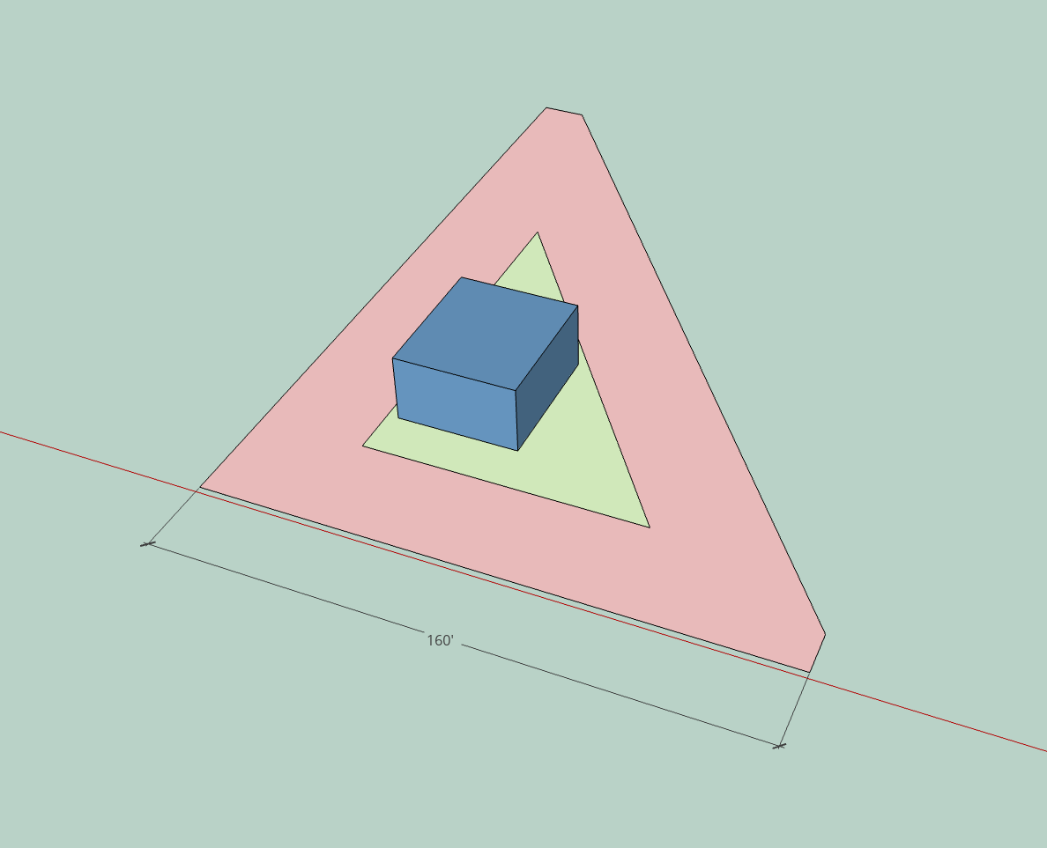

Slide 33
