Slide 1
Use Permit 22-012/
The Villager Motel
February 16, 2023
Mono County Planning Commission

Slide 2
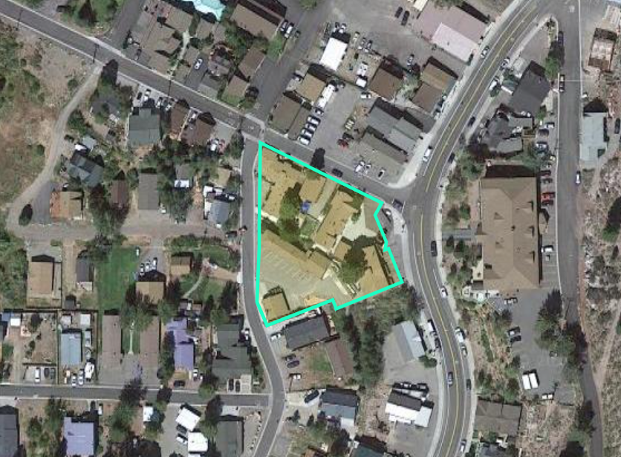
Project Description
The Villager Motel
  7 structures
  26 units
2640 State Highway 158, June Lake
0.76 acres, Commercial
June Lake Central Business District
Replacement of existing structure
  Existing: 2 units, 698 sf
  Proposed: 4 units, 718 sf

Slide 3
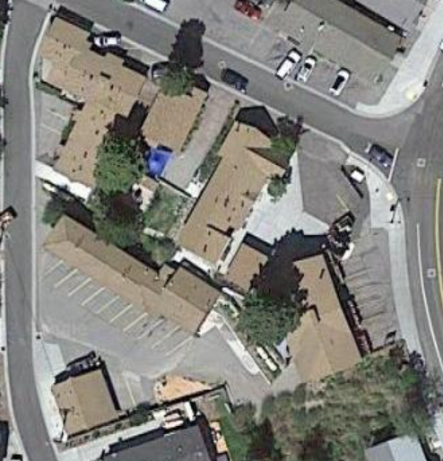
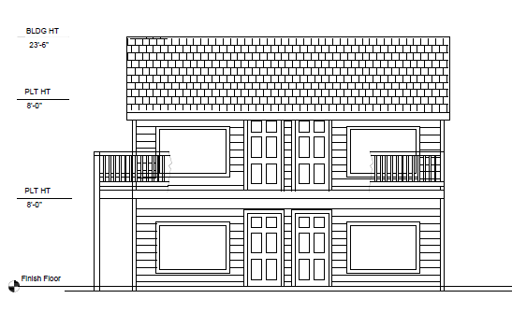

Slide 4
Discussion
Existing nonconforming:
  Lot coverage
  Parking
  Snow storage
  Setbacks; Knoll Avenue and South Crawford Avenue

Slide 5
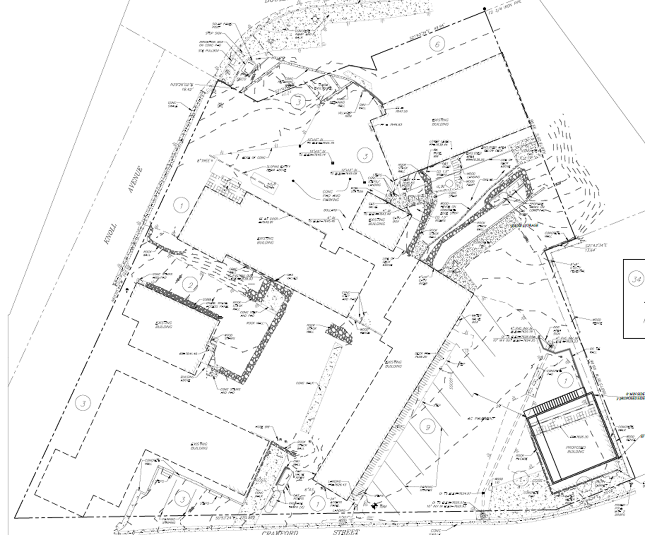

Slide 6
Alternations to nonconforming uses
Alterations of the nonconforming use shall not be detrimental to the intent of the land use designations, objectives and policies, specified in this General Plan.
The granting of permission to alter the nonconforming use shall not be substantially detrimental to the public health, safety or welfare or injurious to the property or improvements in the vicinity or adversely impact the surrounding properties more than the existing nonconforming use.
The alteration shall not increase the intensity of the use-category of the land, building or structure.
If the proposed alteration could generate public controversy, the Director shall refer the application to the Planning Commission for its consideration.

Slide 7
Public Notice and Comments
LDTAC acceptance: October 17, 2022
  Review of Draft Conditions of Approval: February 6, 2023
Published notice on February 4, 2023
No comments received

Slide 8
Use Permit Findings
All applicable provisions of the Mono County General Plan are complied with, and the site of the proposed use is adequate in size and shape to accommodate the use and to accommodate all yards, walls and fences, parking, loading, landscaping and other required features because:
The site for the proposed use related to streets and highways is adequate in width and type to carry the quantity and kind of traffic generated by the proposed use because:
The proposed use will not be detrimental to the public welfare or injurious to property or improvements in the area on which the property is located because:
The proposed use is consistent with the map and text of the Mono County General Plan because:

